Slide 1

ATT&CK Train the Trainer Day 2
September 29th, 2023
Developing with MITRE ATT&CK
Brad Palm
Managing Director of Software
Brian Greunke
Director of Engineering
Notes:
We are gonna get nerdy – go grab some caffeine if you are coming in for a lunch time nap
This is a culmination of working with MITRE ATT&CK since 2016 – Offensive emulation, Defensive recommendations, Threat Hunting, CTI

Slide 2
Agenda
Use Cases / Detections / Analytics
Why should we develop with ATT&CK
Module 1 Lab
Framework and Protocols
How is ATT&CK organized, structured, and communicated?
Module 2 Lab
Data
Where can we obtain ATT&CK data? What factors should be considered?
Module 3 Lab
Versioning
How does ATT&CK handle versions/upgrades and why do we care?
Module 4 Lab
Existing Tools
What does ATT&CK provide? What does our community provide?
Module 5 Lab
Development Time
Real world examples / problems
Module 6 Lab
Notes:
We are going to do a brief intro, Start with Why, and then build a solid support foundation/building blocks, and close with some real-world examples

Slide 3


Brad Palm – Managing Director of Software, Ascent Solutions
Brad Palm
Managing Director of Software
Prior to Product Leader at Ascent, Brad led all cyber services for his previous firm Pathfynder; and was lead strategist and threat hunter for his boutique consulting firm - BruteForce. Prior to life as a civilian, Brad spent 10 years in the Marine Corps as a Combat Engineer, Brad earned a Mechanical Engineering degree from the University of St. Thomas and holds a Master of Science in Computer Science from the Naval Postgraduate School and has certifications with numerous acronyms from various accreditation bodies.
Selected Service Experience
Retail, Finance, Technology, Healthcare, Consumer Packaged Goods/Manufacturing, Government

Slide 4

Brian Greunke – Director of Engineering, Ascent Solutions
Brian Greunke
Director of Engineering
Over the past 15+ years, Brian has had an opportunity to approach technology from multiple vantage points as a software engineer, cloud architect, network analyst, pen tester, threat hunter, and leading teams doing all the above. Prior to building security products at Ascent, he was the Lead Developer for Recon InfoSec. And prior to that, he spent 10 years leading technical and security teams in the United States Marine Corps as a Communications Officer. Brian has a B.S. and M.S. in Computer Science.

Slide 5
Use Cases / Detections / Analytics
Why develop with ATT&CK?
Notes:
We like to start with WHY! Mission drive, eye on the prize.

Slide 6
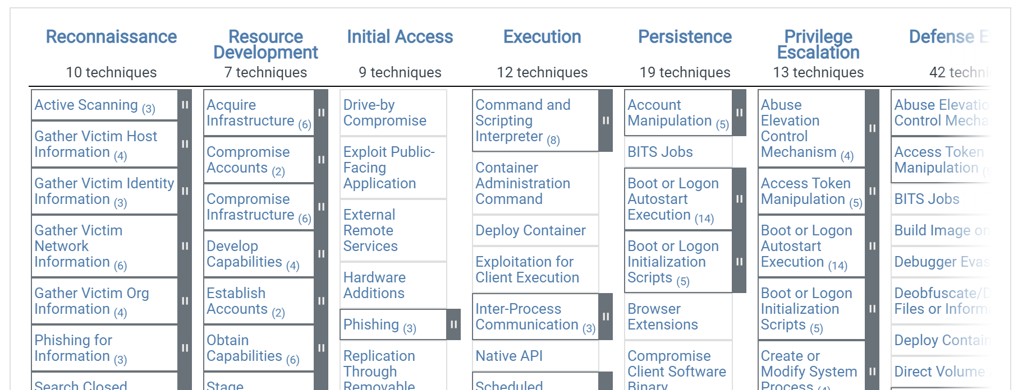
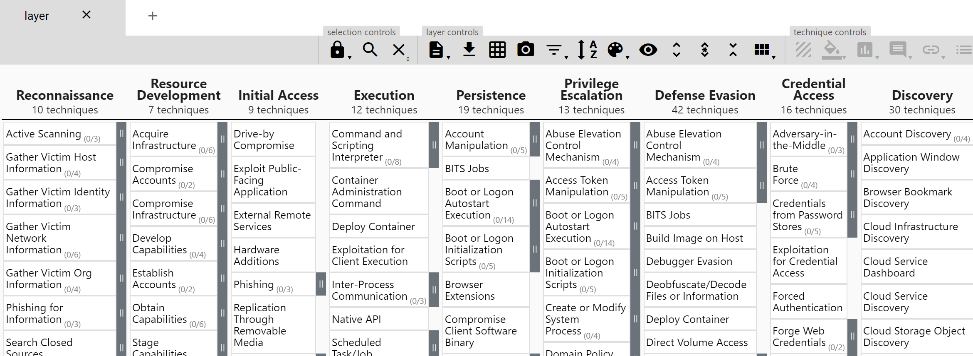

Isn’t ATT&CK Just…
Notes:
Just a matrix we can access online or in navigator…

Slide 7

Humans and Machines are Speaking ATT&CK

Slide 8
How Does ATT&CK Help My Organization
It has become the lexicon in which the cyber security industry communicates and collaborates on combating adversary methods. ALLOWS effective communication, via a shared language:
Across teams, from analyst up to leadership
With security partners and vendors (removes ambiguity of detection coverage and efficacy in products/solutions)
Between software and products
Amongst offensive and defensive internal teams
ENABLES strategic, operational, and tactical level decision making:
Drives gap analysis
Focuses and prioritizes defensive efforts
Supports data-driven decisions
Informs build vs. buy choices
Purple teaming and continuous defensive improvements
FUELS an intel-driven and threat-informed approach to security operations:
Identifying attacker behavior
Assessing defensive coverage
Analyzing opportunities to disrupt
Purposefully designing mitigations and detections
Notes:
From one pager, can breeze through this one
Focus on ATT&CK allows comms, enables decision making, and fuels our intel-driven threat-informed approach to SecOps

Slide 9
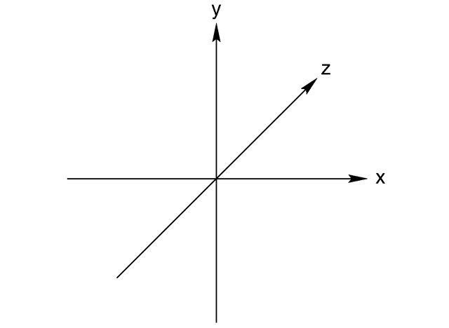

3D Communication
Up the leadership stack
Outside to partners / vendors
Machine Hooman
Across Sec/IT Teams

Slide 10
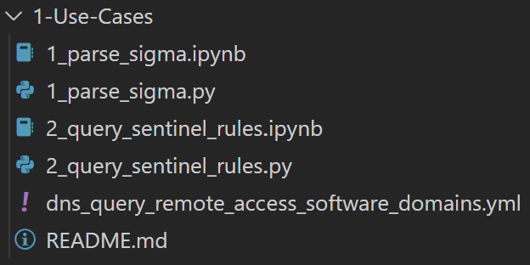
Module 1 Lab
Notes:
Why even develop with ATT&CK?
- (2) Examples of security tools that have it baked in already and are reducing the adoption curve

Slide 11
Framework and Protocols
How is ATT&CK organized, structured, and communicated?
Notes:
What is under the hood?

Slide 12
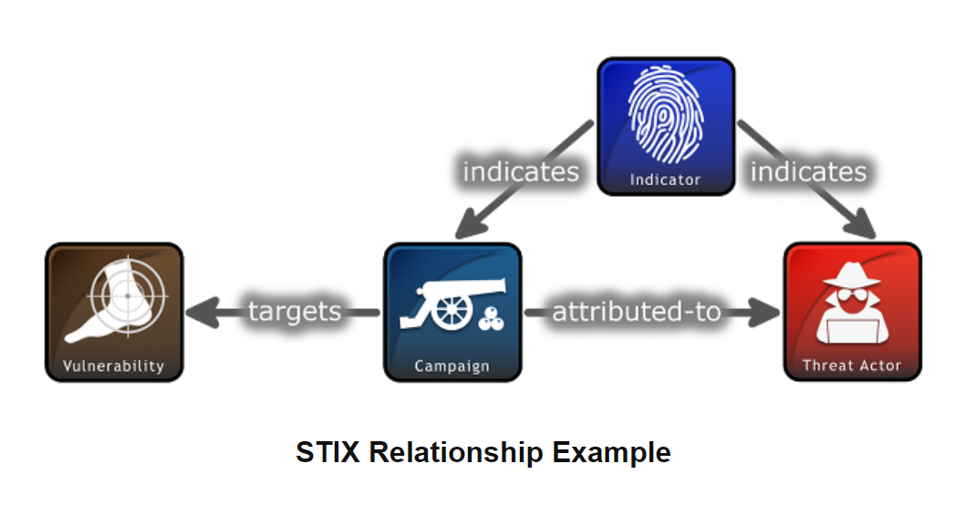
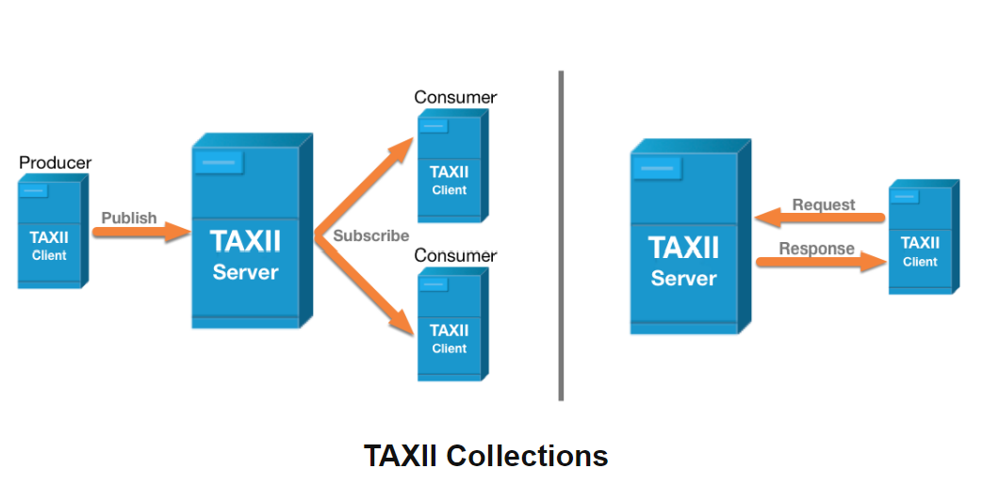
STIX / TAXII
https://oasis-open.github.io/cti-documentation/

Slide 13
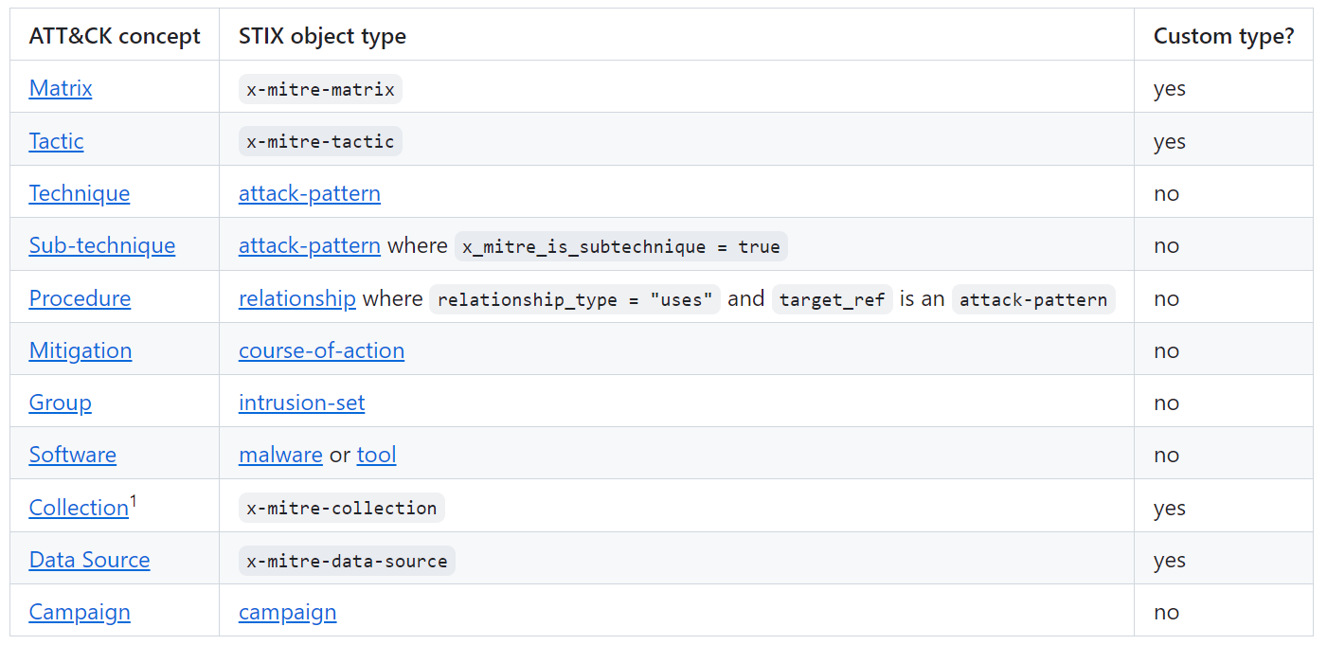
ATT&CK -> STIX Mapping
https://github.com/mitre-attack/attack-stix-data/blob/master/USAGE.md
Notes:
Do we have data sources in STIX?

Slide 14
Data Sources
How we bridge observed offensive actions to potential defensive countermeasures (prevention / detection)
Bi-directional flow is a key mental model to embrace and exploit:
Threat -> {DRIVES} <- Detection/Use Case/Analytic -> {REQUIRES} <- Visibility -> {BUILT ON} <- Data Sources

Slide 15
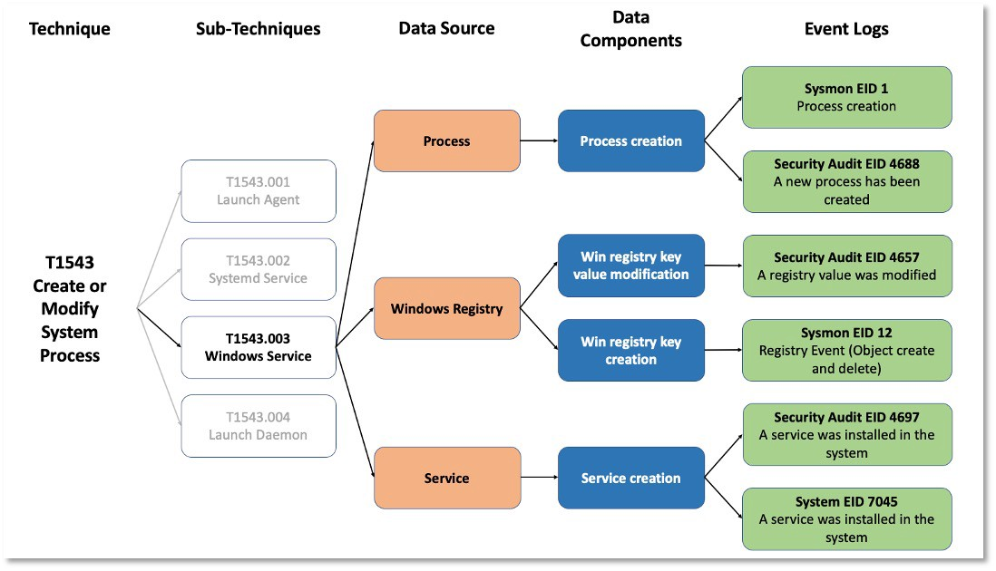
Data Sources Cont’d
Security Tool
Control
MDE
CSF DE.AE/CM/DP
https://medium.com/mitre-attack/defining-attack-data-sources-part-ii-1fc98738ba5b
Notes:
Expand on the bi-directional flow idea working from threat/action to data source and defensive log/solution/framework control

Slide 16
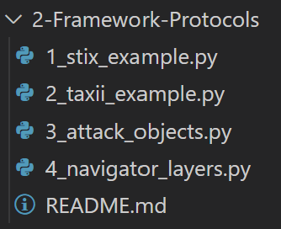
Module 2 Lab
Notes:
What do the data objects look like?
How do we get the data?
ATT&CK Objects (mapping)
Intro to Navigator layer structure

Slide 17
Data
Where can we obtain ATT&CK data? What factors should be considered?

Slide 18
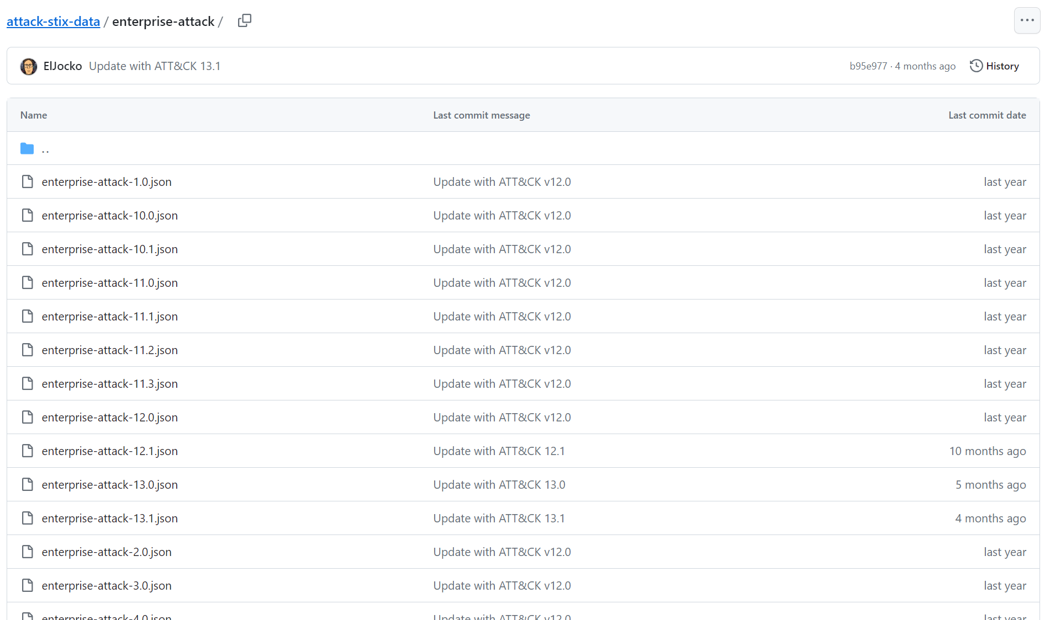
Git Repo

Slide 19
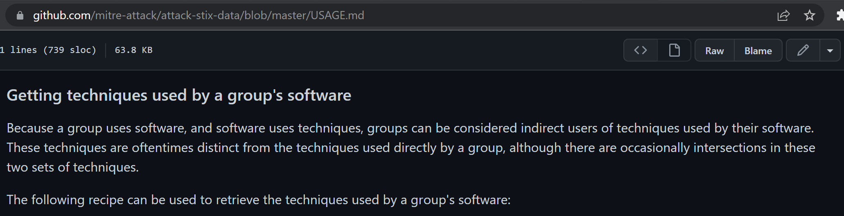
Note About Groups & TTPs & Software
Notes:
https://github.com/mitre-attack/attack-stix-data/blob/master/USAGE.md

Slide 20
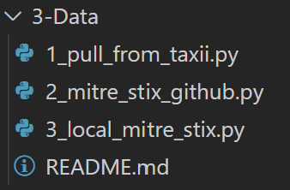
Module 3 Lab
Notes:
Slow, Tees up Group to TTPs + Software mapping discussion, validate techniques pulled from Ajax as it is a smaller cluster
Faster performance, diff data struct JSON -> STIX processing/parsing
Yet again, faster

Slide 21
Versioning
How does ATT&CK handle versions/upgrades and why do we care?

Slide 22
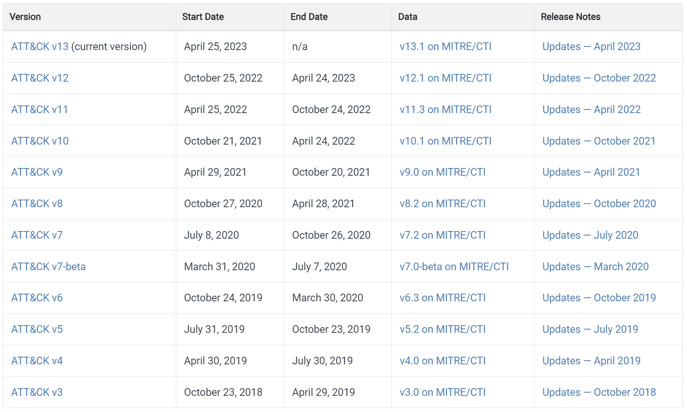
Previous Versions
Data Sources
Sub-Techniques
Versions of ATT&CK
Notes:
Bi-annual releases, some times quarterly updates….

Slide 23
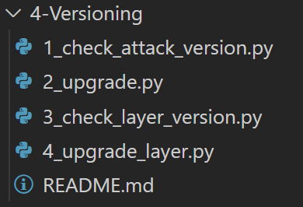
Module 4 Lab
Notes:
Versioning tends to be one of the biggest gotchas when working with ATT&CK and vendors are all over the place on support/versions – 9-11 atm seems to be a reasonable expectation. With many still not mapping to Sub-Technique level!
Check version
Upgrade from v6 to v11 – we can not find a maintained MITRE mapping to use, aside from STIX data. This gives us a smaller subset to consider for mapping upgrades.
Navigator layers also have versions – show pain points of Nav layer upgrade process
Upgrade a layer is a common task – at least twice a yr, and you need to handle breaking changes!

Slide 24
Existing Tools
What does ATT&CK provide? What does our community provide?

Slide 25
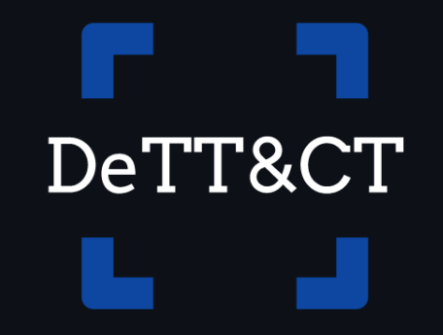
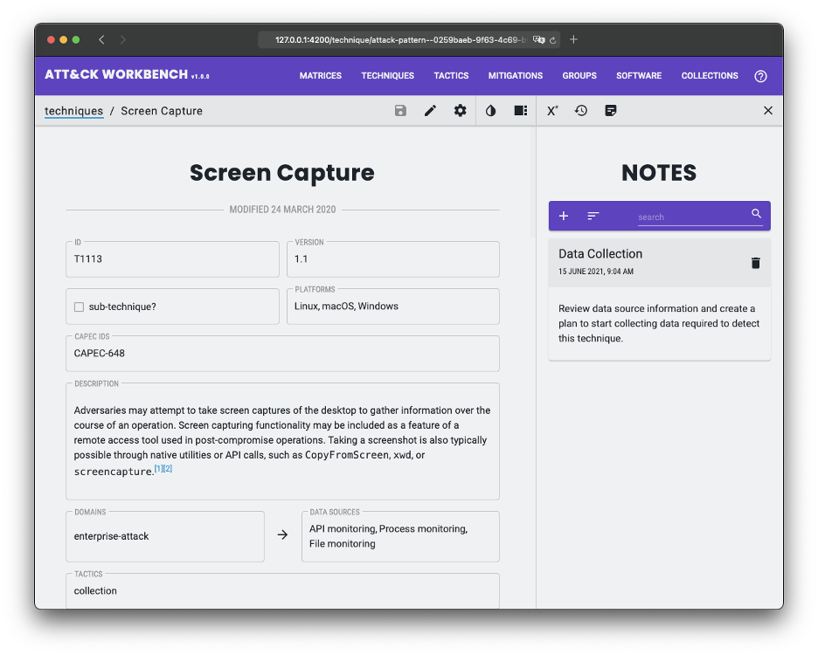
ATT&CK Resources Page
ATT&CK in STIX
ATT&CK in Excel
ATT&CK Navigator
ATT&CK Python Utilities
DeTT&CT
“mapping your blue team to ATT&CK”
Multi-level scoring, differentiation between visibility and detection and separation based on platforms and data sources
Allows you to score your data sources, visibility coverage, and detections WRT ATT&CK
ATT&CK Workbench
Extending ATT&CK/Navigator
https://attack.mitre.org/resources/working-with-attack/

Slide 26
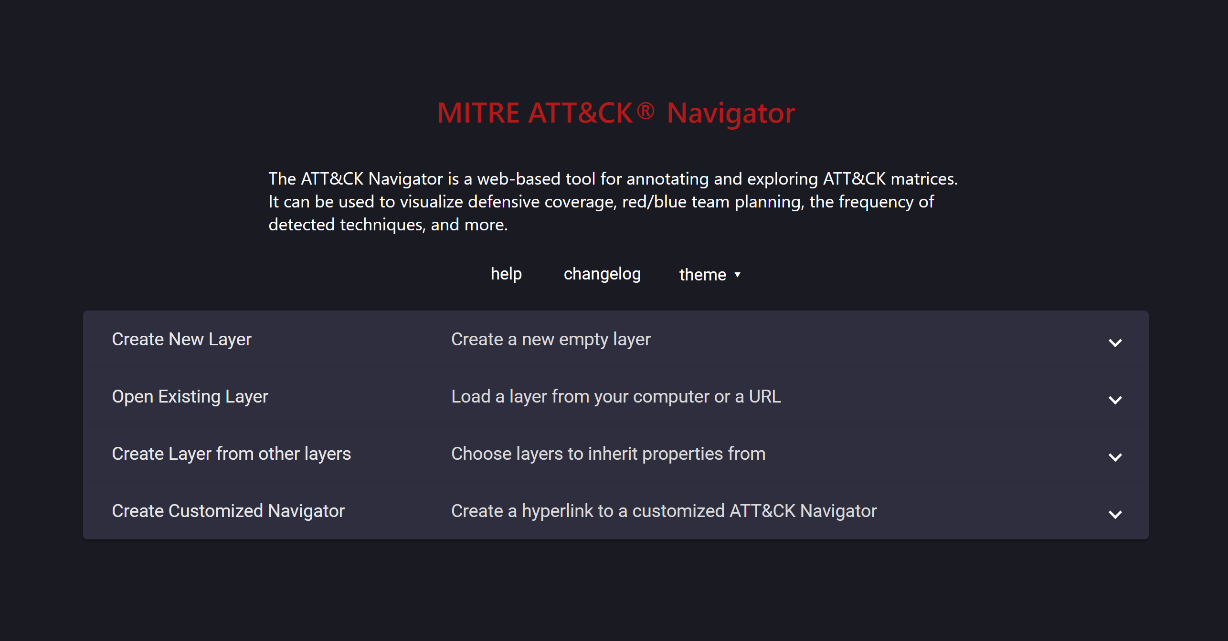
ATT&CK Navigator
Leveraging Navigator for analysis
ATT&CK® Navigator (mitre-attack.github.io)
Notes:
Follow link to Navigator and give orientation to the tool before the drill down into threat and defensive coverage
Orient/navigate/prep for deep dive – some of this is lost when pivoting from our static web page workbench, so take time to get them familiar with the tool

Slide 27
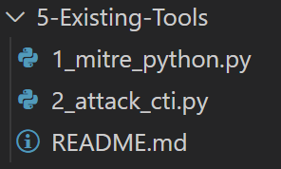
Module 5 Lab
Notes:
Mitre ATT&CK Python pip library examples
OTRF – Roberto attackcti example

Slide 28
Development Time
Real World Examples / Problems
Notes:
This is the punchline – led off with Why, and this is Mission complete stage

Slide 29

Make it Your Own, Embrace It!

Slide 30
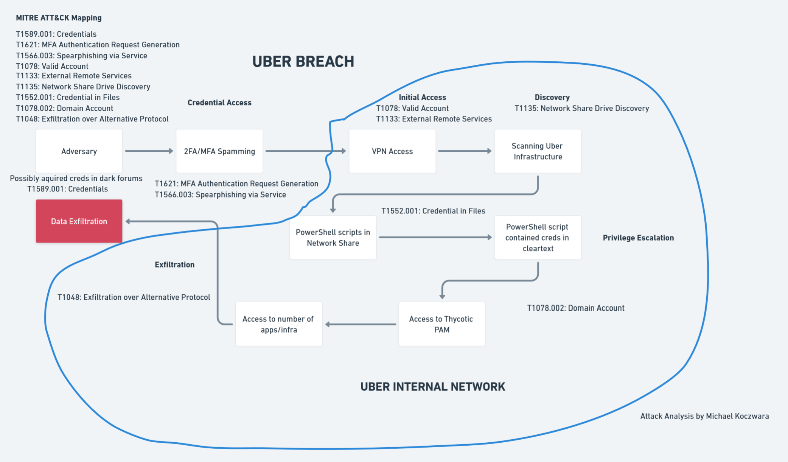
CTI / IR Work
Notes:
https://www.microsoft.com/security/blog/2022/03/22/dev-0537-criminal-actor-targeting-organizations-for-data-exfiltration-and-destruction/

Slide 31
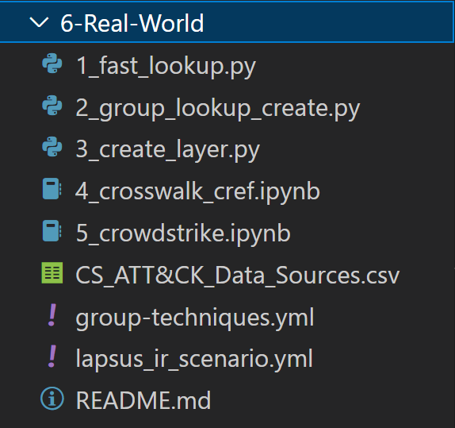
Module 6 Lab
Notes:
Recasting obj into something more friendly to work with
CTI/IR report scenario
Creating layers….

